Slide 1


SIMATS ENGINEERING
CSA1516-Cloud Computing and Big Data Analytics using CSP
CLOUD BASED CHATBOT FOR COLLEGE
ENQUIRY
Team Members:
R.Jaideep (192525441)
Muhammed Sanin Febin(192511169)
Yenumula Naga Giridhar(192572124)
Melwin Joe J(192421380)
Guided By :
Santhiya Lakshmi K

Slide 2

INTRODUCTION
A cloud-based chatbot is an automated system used to answer college-related questions.
It helps students and parents get information about admissions, courses, fees, and campus facilities.
The chatbot works online using cloud technology, so it is
available 24/7.
Users can interact with the chatbot through simple text-based question.
This system makes the enquiry process faster and reduces
manual work for college staff.

Slide 3
PROBLEM STATEMENT
Students and visitors face difficulty in accessing college information quickly.
Traditional enquiry methods can be time-consuming and require staff assistance.
College staff spend significant time responding to repetitive questions.
Users may not receive immediate support outside regular college working hours.
There is a need for a smart, cloud-based chatbot to provide quick and accurate information.

Slide 4
Literature Review / Background
Author / Source | Year | Technology / Method Used | Key Findings | Limitations
IJNRD | 2026 | AI-Based College Enquiry Chatbot with NLP & TF-IDF | Provides instant responses to student queries and reduces administrative workload | Requires continuous knowledge-base updates (IJNRD)
RJ Wave Journal | 2026 | Python + NLTK + NLP Chatbot | Automates admission, course, and fee enquiries with improved response accuracy | Limited by training data and predefined knowledge base (RJWAVE Research Journal)
IJRASET | 2026 | Conversational AI (Azure & Rasa) | Cloud-based conversational AI offers personalized and scalable student support | More complex implementation than rule-based systems (IJRASET)
Sirnoorkar & Mamidpalliwar | 2026 | LLM-Based Educational Chatbot | AI chatbots improve learning support and guided student interaction | Performance varies with user interaction preferences (arXiv)

Slide 5
OBJECTIVES
To develop an interactive chatbot for handling college-related enquiries.
To provide quick and accurate information about courses, admissions, fees,
and facilities.
To store and manage college information securely using cloud database
technology.
To reduce the workload of college staff by automating repetitive enquiries.
To provide 24/7 access to college information for students and visitors.

Slide 6
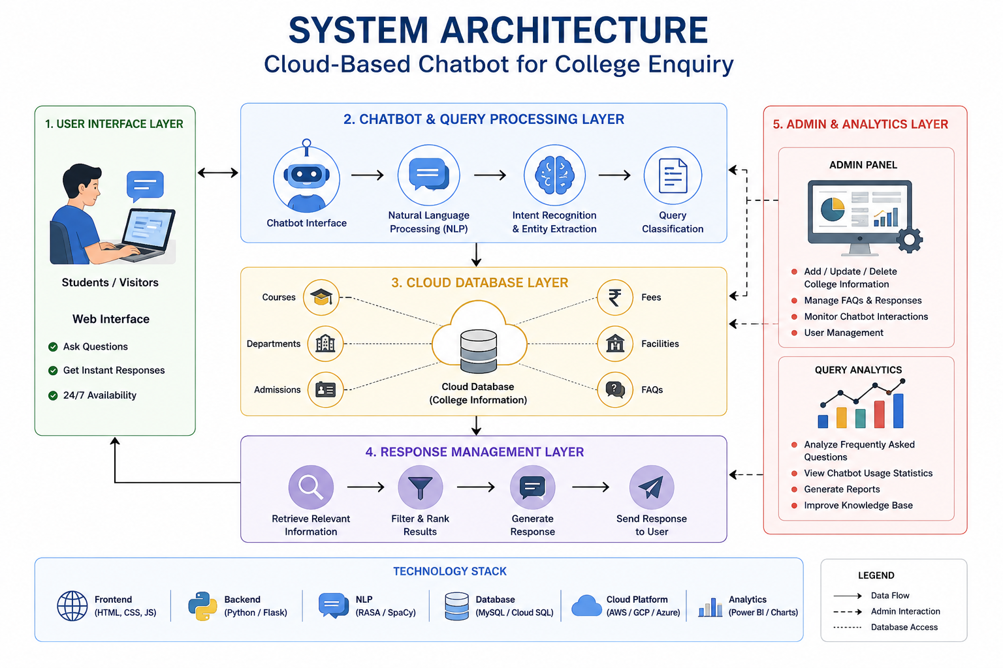
SYSTEM ARCHITECTURE

Slide 7



MODULE 1- CHATBOT INTERACTION & QUERY PROCESSING
Provides an interactive chatbot interface for students and visitors to ask
college-related questions.
Accepts and processes user queries using natural language processing
techniques.
Identifies the user's intent and matches the query with relevant college
information.
Provides quick and accurate responses about admissions, courses, fees,
departments, and facilities.
Maintains a smooth conversation flow and improves the overall user enquiry
experience.

Slide 8

MODULE 2- CLOUD DATA BASE & RESPONSE
MANAGEMENT
Stores all college information, such as admissions, courses, fees, faculty details, and announcements, in a secure cloud database.
Retrieves relevant information quickly based on the student's enquiry and provides accurate responses.
Uses AI and Natural Language Processing (NLP) to understand user queries and generate appropriate replies.
Allows administrators to update the database in real time, ensuring students always receive the latest information.
Ensures secure, scalable, and reliable access to data, enabling the chatbot to serve multiple users anytime and anywhere.

Slide 9
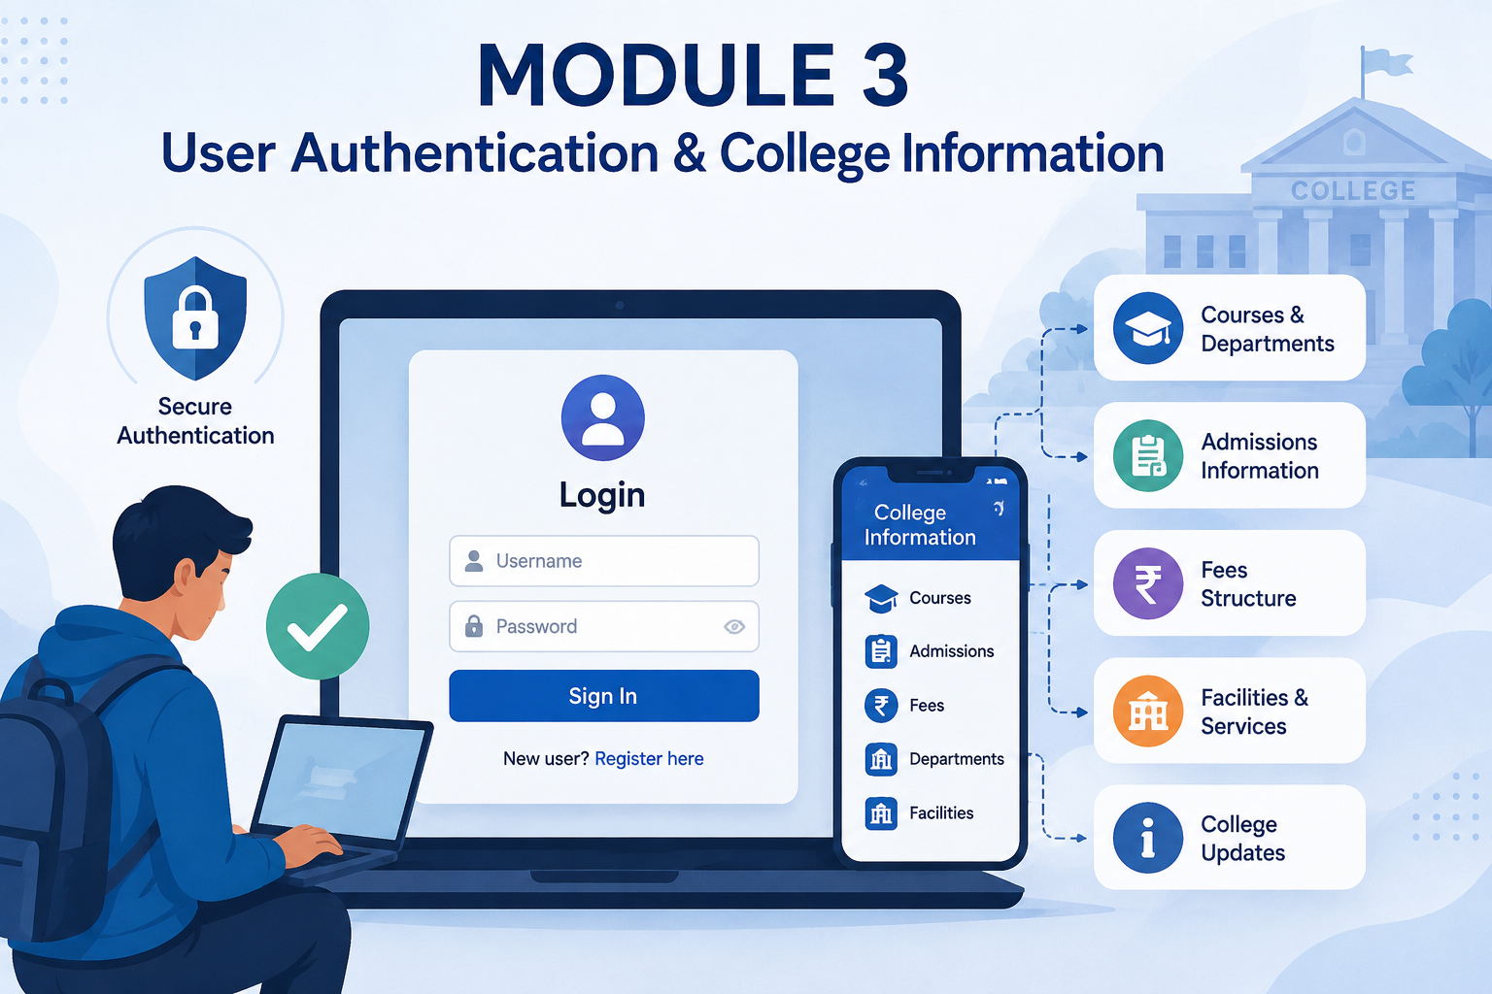
Module 3 – User Authentication & College Information
Stores user account details securely and manages login authentication
Maintains student and visitor profiles with secure access control.
Retrieves and displays college information such as courses,
departments, admissions, and fees.
Provides personalized access to chatbot services after successful
login.
Allows users to securely access and explore college information
anytime.

Slide 10
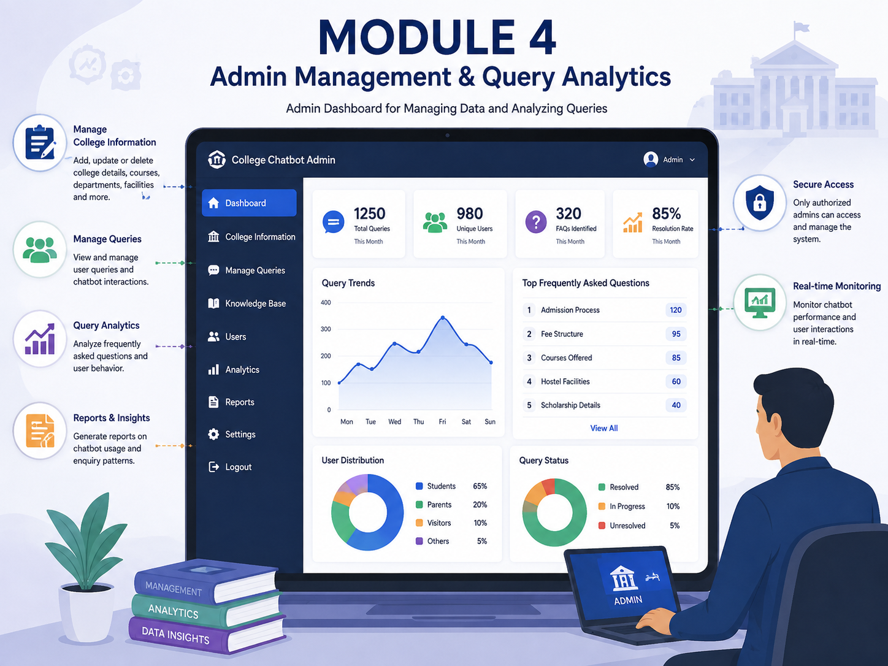
Module 4 –Admin Management & Query Analytics
Provides a secure admin dashboard to manage and control the chatbot system.
Allows administrators to add, update, and delete college information stored in the system.
Enables admins to monitor user queries and review chatbot interactions.
Analyzes frequently asked questions to identify common student and visitor requirements.
Generates useful reports on chatbot usage and user enquiry patterns.

Slide 11
CONCLUSION
Overall, the chatbot improves communication efficiency and user experience in colleges.
Cloud technology makes the chatbot scalable, reliable, and easy to maintain.
The system reduces the workload of college staff by handling repeated questions.
It helps students and parents get information anytime without visiting the college.
The cloud-based chatbot provides quick and accurate answers to college enquiries.

Slide 12
REFERENCES
AI Based Chatbot for College Enquiry System. (2026). International Journal of Engineering Research and Science & Technology, 22(2), 318–324. https://doi.org/10.62643/IJERST.2026
Badger, M., López, N., & Nissen, C. F. R. (2026). The Impact of GenAI Chatbots on Student Learning in Higher Education: A Literature Review. International Journal of Technology in Education, 9(1), 43–69.
Smutny, P., & Schreiberova, P. (2026). From Rules to Language Models: A Comparative Study of Chatbot Learning Assistants. Frontiers in Education, 11. https://doi.org/10.3389/feduc.2026.1794807
Nambia, A. R., & Devi, H. S. (2026). A Systematic Review of AI Chatbots in Education Using NLP and LLMs. International Journal of Latest Technology in Engineering Management & Applied Science. https://doi.org/10.51583/IJLTEMAS.2026.150500038
Meyer, K. E., Page, L. C., Mata, C., Smith, E., Walsh, B. T., Fifield, C. L., Tyson, M., Eremionkhale, A. E., Evans, M., Frost, S., & Jung, E. E. (2026). Let's Chat: Leveraging Chatbot Outreach for Improved Course Performance. National Bureau of Economic Research (NBER Working Paper No. 35397). https://doi.org/10.3386/w35397

Slide 13


